Slide 1
網路概論實習課L16

Slide 2
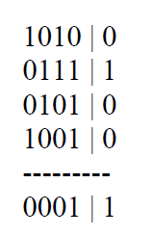
P1. Suppose the information content of a packet is the bit pattern 1010 0111 0101 1001 and an even parity scheme is being used . What would the value of the field containing the parity bits be for the case of a two-dimensional parity scheme? Your answer should be such that a minimum-length checksum field is used.
ANS

Slide 3
P5. Consider the generator , G=1001 ,and suppose that D has the value 11000111010. What is the value of R?
1101110011
1001)11000111010000
1001
1010
1001
1111
1001
…..
110

Slide 4
P6.Rework the previous problem , but suppose that D has the value
a.01101010101 Ans:011
b.11111010101 Ans:011
c.10001100001 Ans:110

Slide 5
a.
0110011
b.
1110011
1001)
01101010101
1001)
11111010101
0000
1001
1101
1101
1001
1001
1000
1000
1001
1001
1101
1101
1001
1001
1000
1000
1001
1001
011
011

